Slide 1
Mid bootcamp project
René van Schalkwyk
September 2021

Slide 2

What are the features of a popular song, and are there any noticeable trends?
I tried to answer this question by performing an analysis of the charts made available by Spotify, making use of the following for the period 1 Jan 2017 to 31 Aug 2021:
Spotify daily charts
Includes the top200 popular tracks global and per region
Chart is driven by the number of streams a track has
Viral50 charts
Looks at user sharing on blogs, social media, etc. of tracks

Slide 3
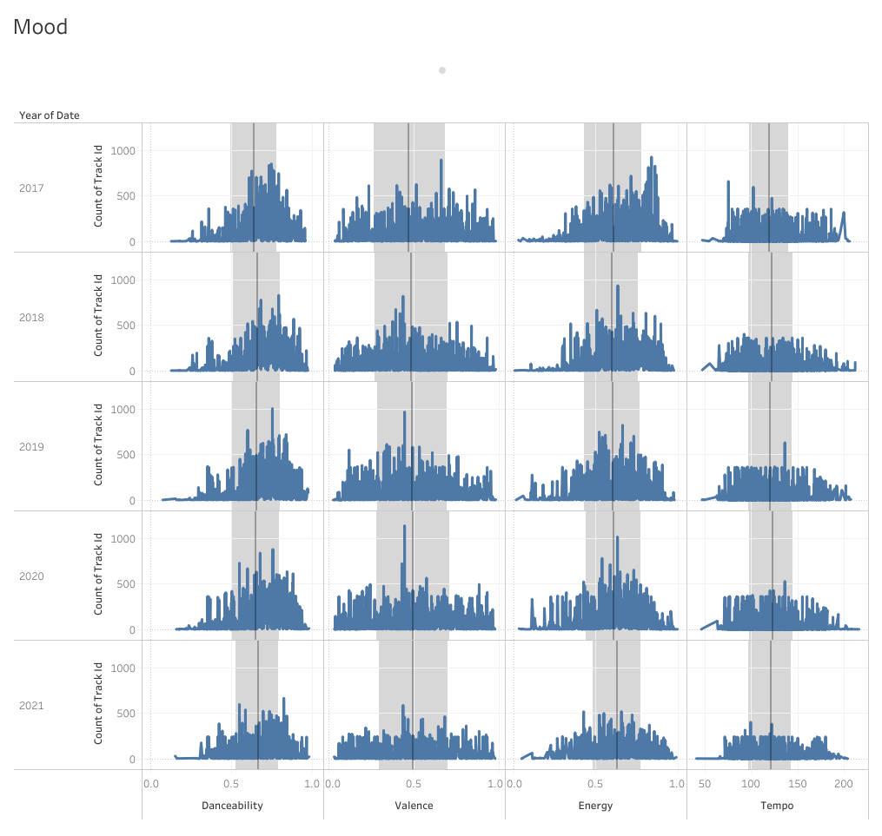
danceability Danceability describes how suitable a track is for dancing based on a combination of musical elements including tempo, rhythm stability, beat strength, and overall regularity. A value of 0.0 is least danceable and 1.0 is most danceable.
Spotify provides audio features for tracks.
Looking over a period of 5 years, these features follow a very similar pattern.
valence A measure from 0.0 to 1.0 describing the musical positiveness conveyed by a track. Tracks with high valence sound more positive (e.g. happy, cheerful, euphoric), while tracks with low valence sound more negative (e.g. sad, depressed, angry)
energy Energy is a measure from 0.0 to 1.0 and represents a perceptual measure of intensity and activity. Typically, energetic tracks feel fast, loud, and noisy. For example, death metal has high energy, while a Bach prelude scores low on the scale. Perceptual features contributing to this attribute include dynamic range, perceived loudness, timbre, onset rate, and general entropy.
tempo The overall estimated tempo of a track in beats per minute (BPM). In musical terminology, tempo is the speed or pace of a given piece and derives directly from the average beat duration.

Slide 4
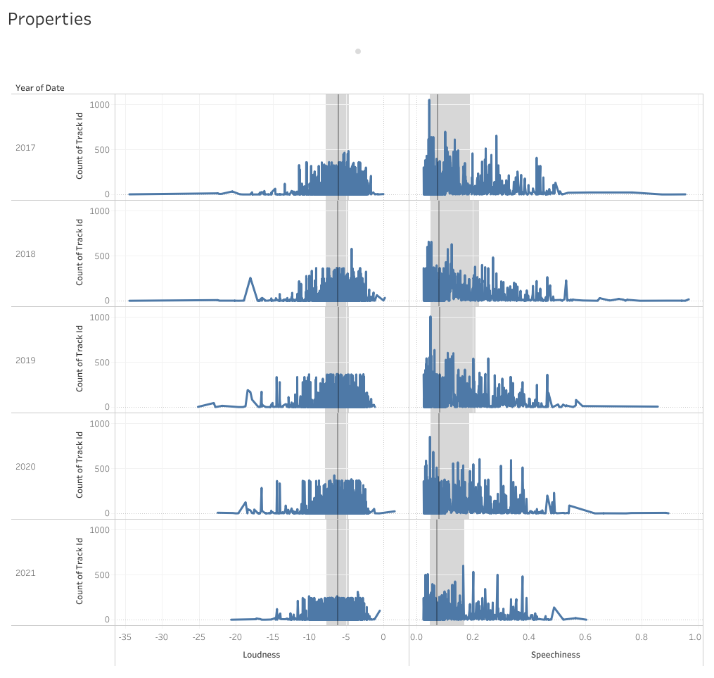
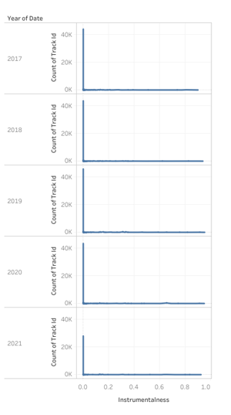
loudness The overall loudness of a track in decibels (dB). Loudness values are averaged across the entire track and are useful for comparing relative loudness of tracks. Loudness is the quality of a sound that is the primary psychological correlate of physical strength (amplitude). Values typical range between -60 and 0 db.
speechiness Speechiness detects the presence of spoken words in a track. The more exclusively speech-like the recording (e.g. talk show, audio book, poetry), the closer to 1.0 the attribute value. Values above 0.66 describe tracks that are probably made entirely of spoken words. Values between 0.33 and 0.66 describe tracks that may contain both music and speech, either in sections or layered, including such cases as rap music. Values below 0.33 most likely represent music and other non-speech-like tracks.
instrumentalness Predicts whether a track contains no vocals. “Ooh” and “aah” sounds are treated as instrumental in this context. Rap or spoken word tracks are clearly “vocal”. The closer the instrumentalness value is to 1.0, the greater likelihood the track contains no vocal content. Values above 0.5 are intended to represent instrumental tracks, but confidence is higher as the value approaches 1.0.

Slide 5
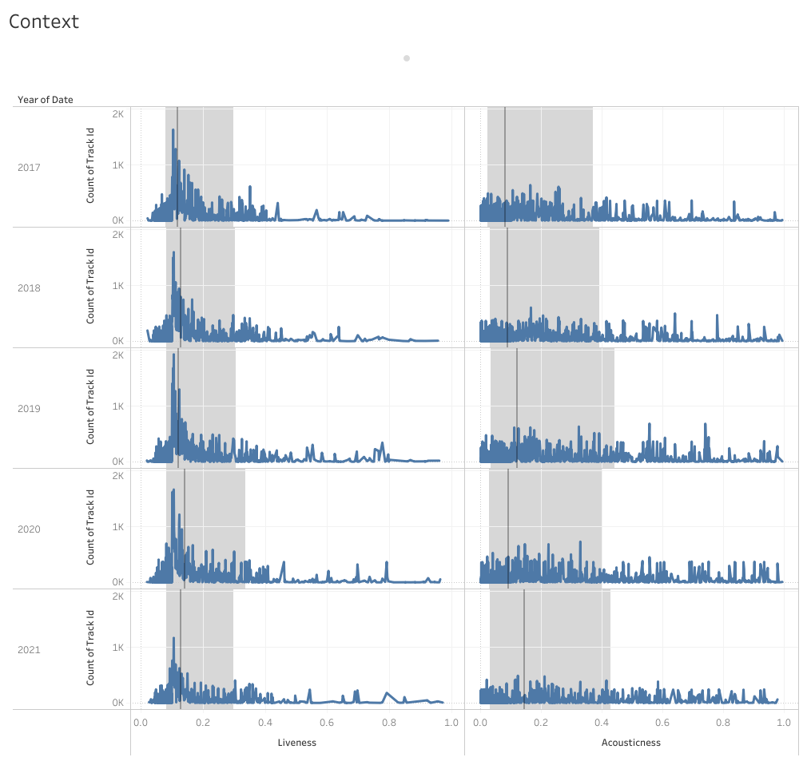
liveness Detects the presence of an audience in the recording. Higher liveness values represent an increased probability that the track was performed live. A value above 0.8 provides strong likelihood that the track is live.
acousticness A confidence measure from 0.0 to 1.0 of whether the track is acoustic. 1.0 represents high confidence the track is acoustic.

Slide 6
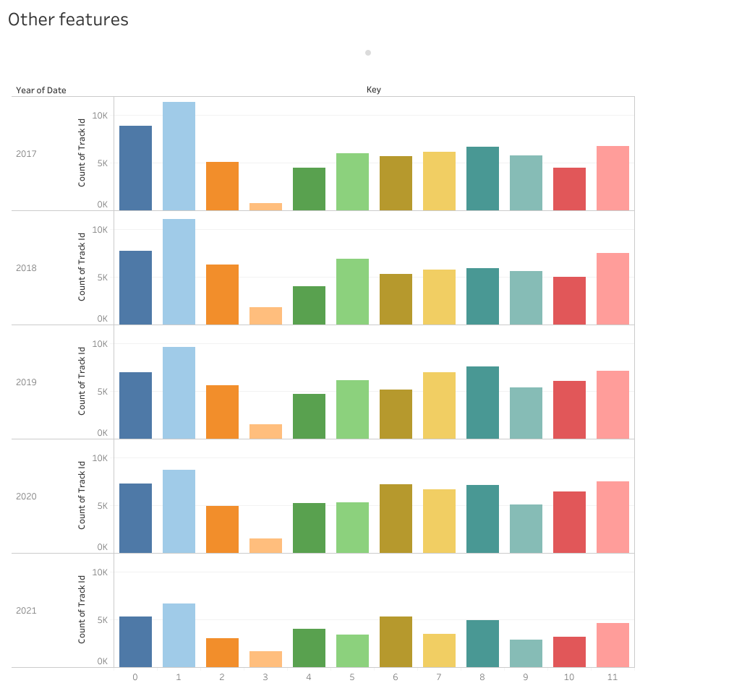
key The key the track is in. Integers map to pitches using standard Pitch Class notation. E.g. 0 = C, 1 = C♯/D♭, 2 = D, and so on.

Slide 7
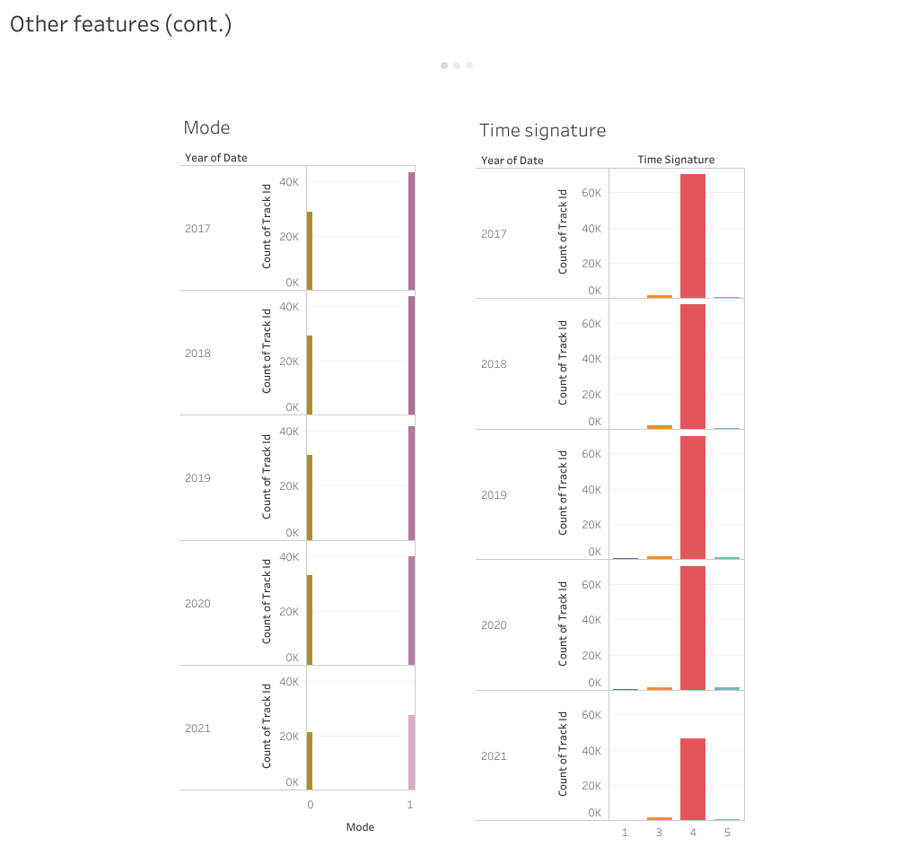
mode Mode indicates the modality (major or minor) of a track, the type of scale from which its melodic content is derived. Major is represented by 1 and minor is 0.
time_signature An estimated overall time signature of a track. The time signature (meter) is a notational convention to specify how many beats are in each bar (or measure).

Slide 8
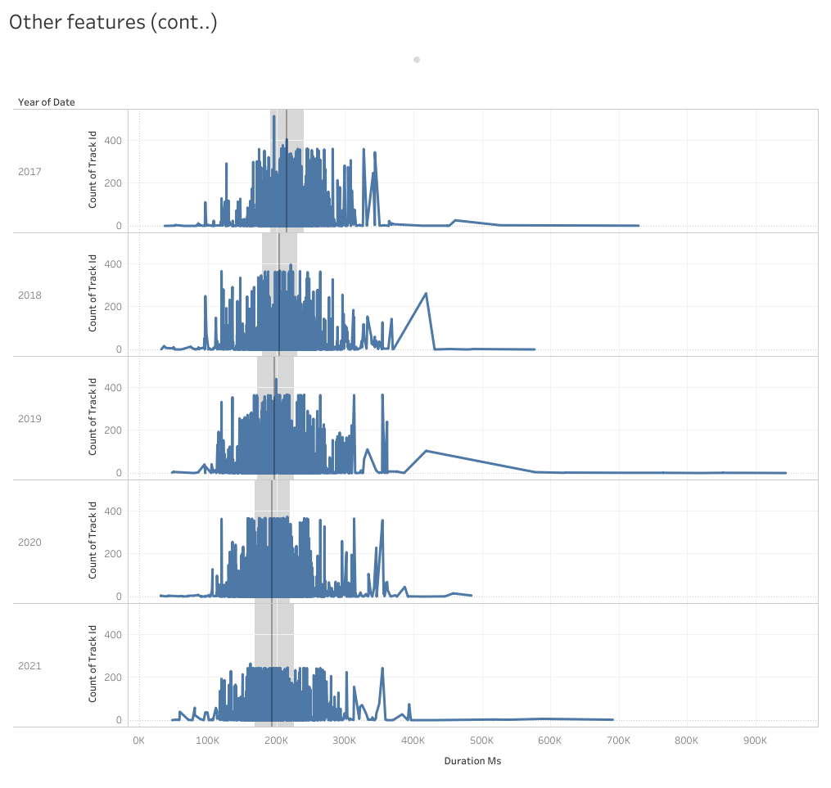
duration_ms The duration of the track in milliseconds.

Slide 9
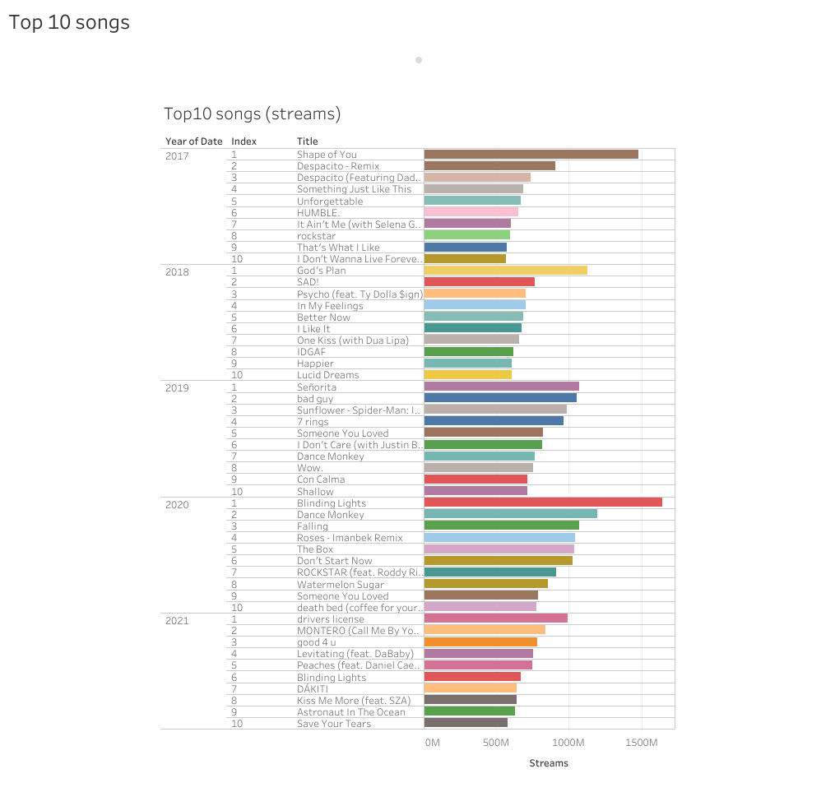

Slide 10
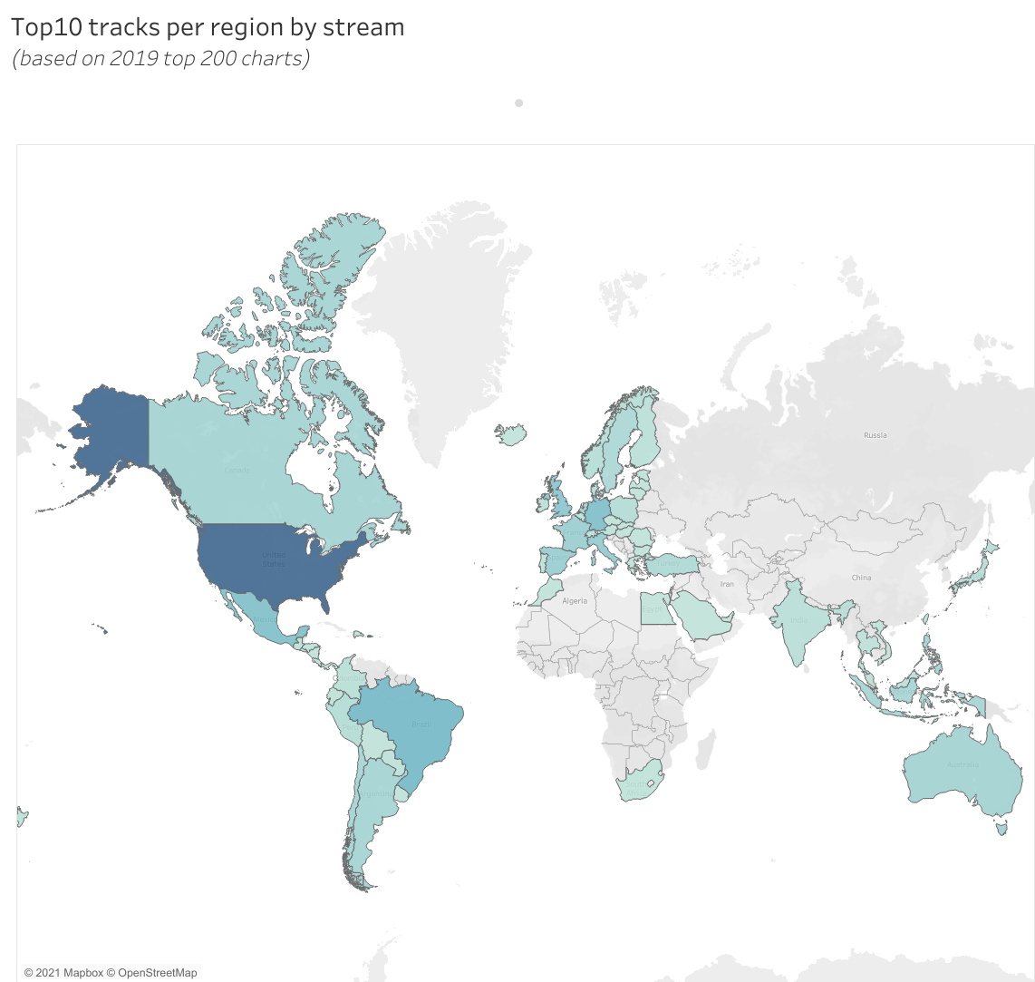
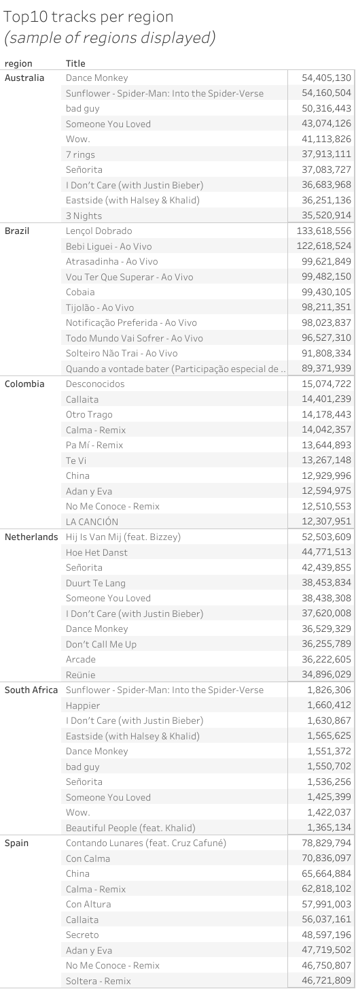

Add a Slide Title - 1
Audio features

Slide 11
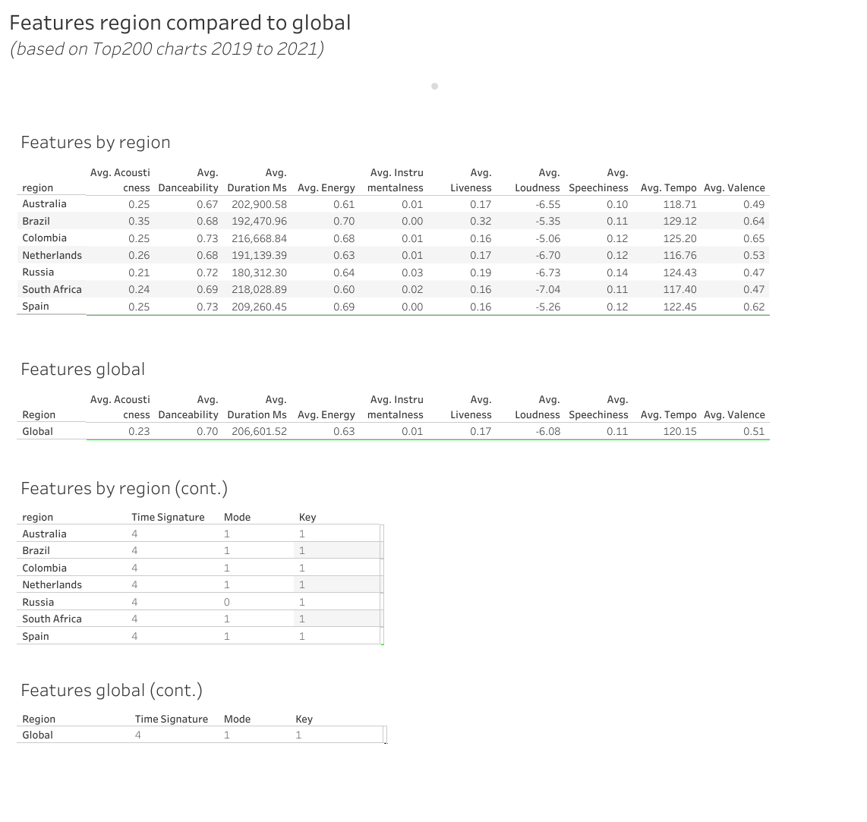
The top10 tracks from the regions vary a lot as can be seen from the previous slide.
When comparing the averages of the track features for a sample of regions to the global chart, these seem to be in a similar range.

Slide 12
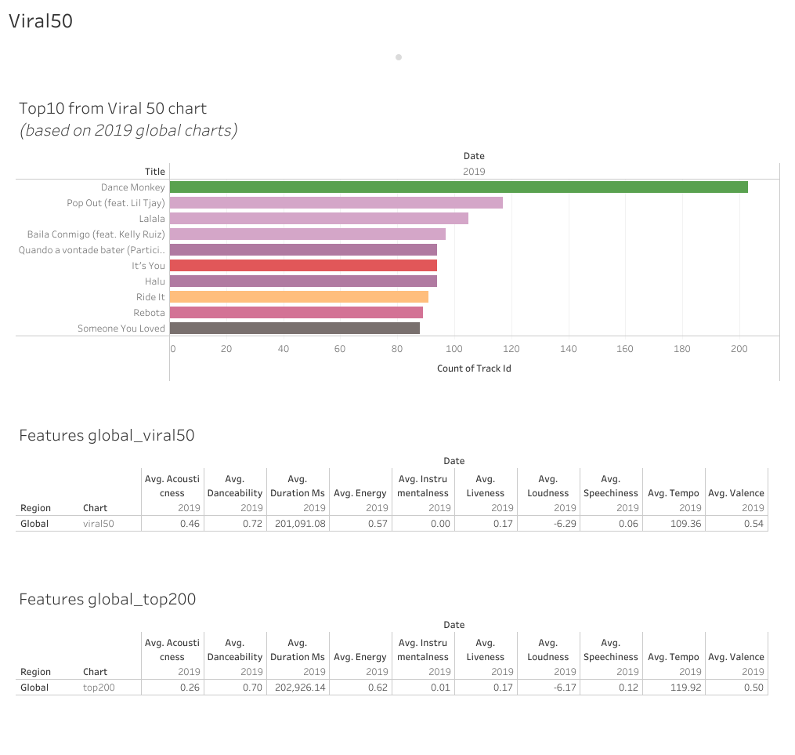
The top10 tracks from the viral50 chart differ quite a lot from the top200 chart.
When comparing the averages of the track features of these global charts, these seems to be in a similar range.

Slide 13
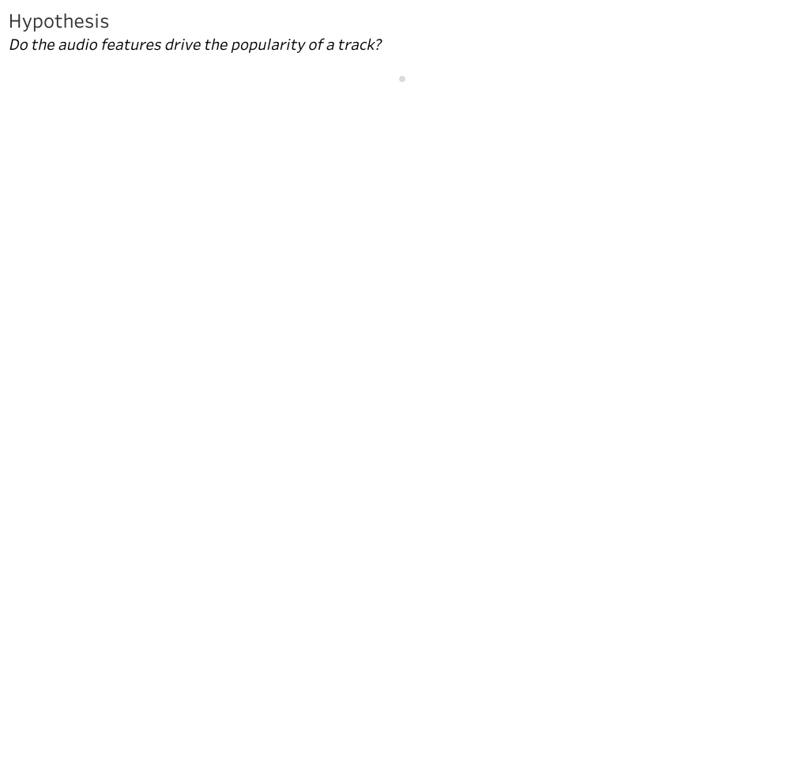
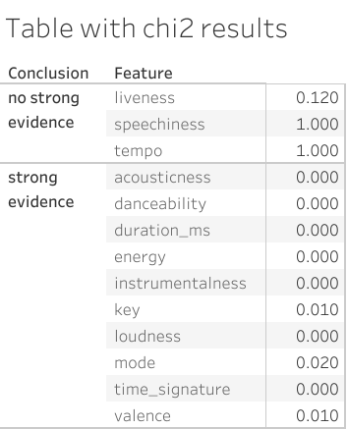
To test this hypothesis, I used the Top200 Global chart and performed the following tests:
Test correlation of track features vs. total number of streams using a heatmap.
No high correlations were noted.
Test track features vs. popularity using chi2.
There is an artist object in the dataset called “popularity”, which is described below on Spotify’s website:
popularity
The popularity of the artist. The value will be between 0 and 100,
with 100 being the most popular. The artist’s popularity is calculated
from the popularity of all the artist’s tracks.
Testing these features against popularity using the chi2, for certain features there are NO strong evidence to support that the features are related / not independent.
For certain other features, there were strong evidence that the variables are related / not independent. See table with chi2 results for outcome.

Slide 14
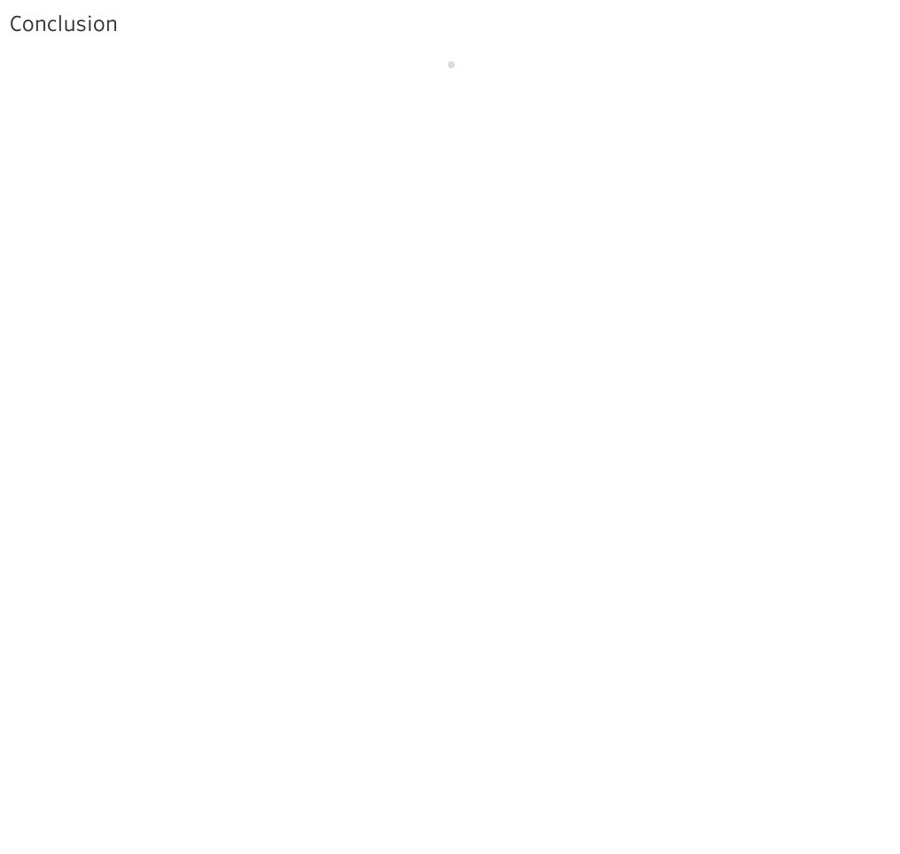
A similar pattern is noticeable in the track features, at least looking over a 5-year timespan
When looking at tracks that are popular on the global chart vs. popular tracks per region, the titles vary quite a lot. However, looking at the audio features, these are very similar when comparing the averages.
The same is noticed when comparing the viral50 vs. the top 200 chart where most of the features appear to be in a similar range.
Following from the hypothesis testing, it appears as if certain track features could drive the popularity of a track.

Slide 15
Data sets and sources:
From <https://www.kaggle.com/dhruvildave/spotify-charts>
From <https://developer.spotify.com/documentation/web-api/reference/#object-audiofeaturesobject>
From <https://levelup.gitconnected.com/extracting-and-analysing-spotify-tracks-with-python-d1466fc1dfee
From <https://www.kaggle.com/ivannatarov/spotify-daily-top-200-songs-with-genres-20172021>

